Slide 1
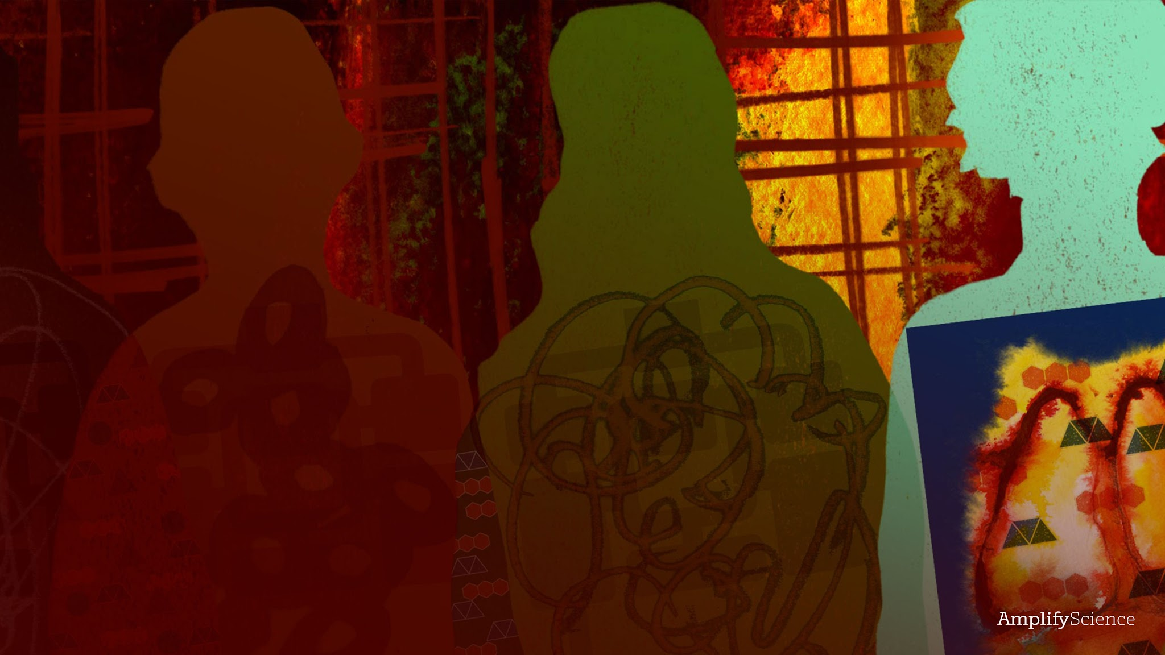
Metabolism
Lesson 2.4: Conducting Sim Tests

Slide 2
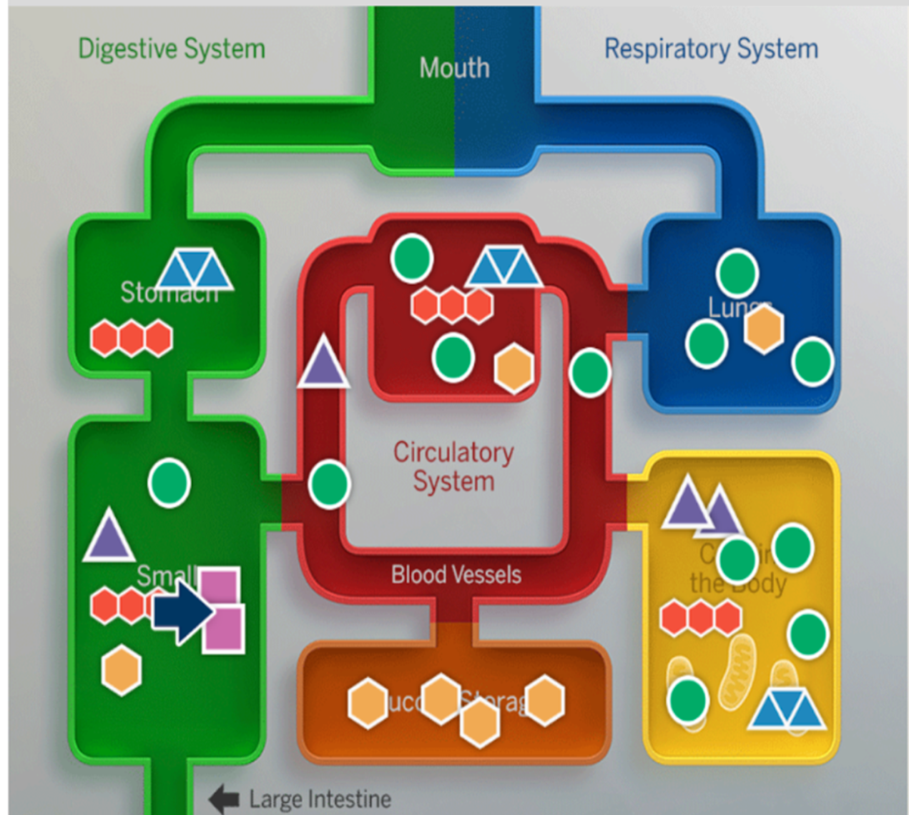
Warm-Up
An intern at the hospital created this model to show what happens to the molecules in a healthy person’s body after they eat and breathe. The model has some very big mistakes. Press the + to make annotations on the image to explain to the intern what is inaccurate about the model.
These sentence starters can help you:
This molecule would not be found in this body system because
This molecule would not be found in the cells in the body because . . .

Slide 3
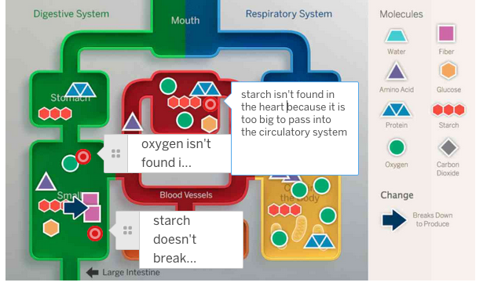
Warm-Up

Slide 4
Investigation Question:
How can having a medical condition affect the delivery of molecules to cells in the body?

Slide 5
Making Comparisons with the Sim
In the Sim, you’ll observe both a healthy body and a body with the condition you’ve been learning about.
You will gather data about the molecules delivered to the cells in a healthy body and compare that to what happens in a body with a medical condition.
Open the Metabolism SIM and follow the instructions and answer the questions on pages 38-40

Slide 6
Key Concept 7:
A problem with a body system can result in fewer oxygen, glucose, and/or amino acid molecules getting to the body’s cells.

Slide 7
Word Relationship
Word Bank
oxygen
respiratory system
circulatory system
cells
starch
digestive system
You’ll use the Word Relationships routine to create sentences that use these words and answer questions about the conditions you’ve learned about

